Slide 1
Emission Design Medical mission simple patient records
Paul H Alfille MD 2023

Slide 2
Goals
Patient data for medical care during mission
All mission members can see and add data
Pictures
Notes
Operations
Followup
Searchable
Stored securely
Downloadable
Platform
Phone
Pad
Laptop
Works with limited connectivity
Easily deployable
Intiuitive simple design
Minimal administrative burden

Slide 3
General design choices
Local
Central
User’s phone
Wifi or cellular
Camera for pictures
Web browser based
Local copy of
Data
Program
automatically obtained and refreshed
Security
Phone local
SSL data communication
Cloud server
Databases
List of missions
User/Password check
Intermittent update to<->from users (synchronization)
Each mission with separate database

Slide 4
Technical design choices
Local
Central
Javascript application
PouchDB for database
Web browser
Display
Database
Cookies
Application code cache
CouchDB protocol to server
Cookies for persistent user/password/database selection
CouchDB database application
SSL certificate
SSL for database communication
Https for web traffic
Lighttp web server
Application download (automatic)
Instruction pages (via markdown rendering)

Slide 5
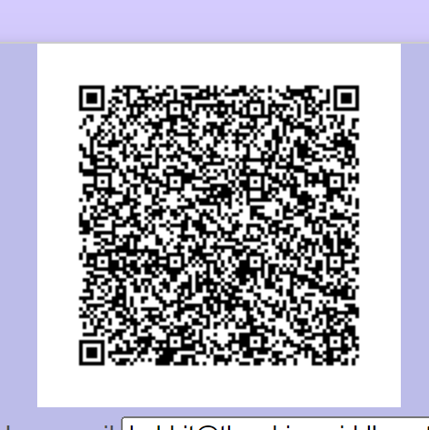
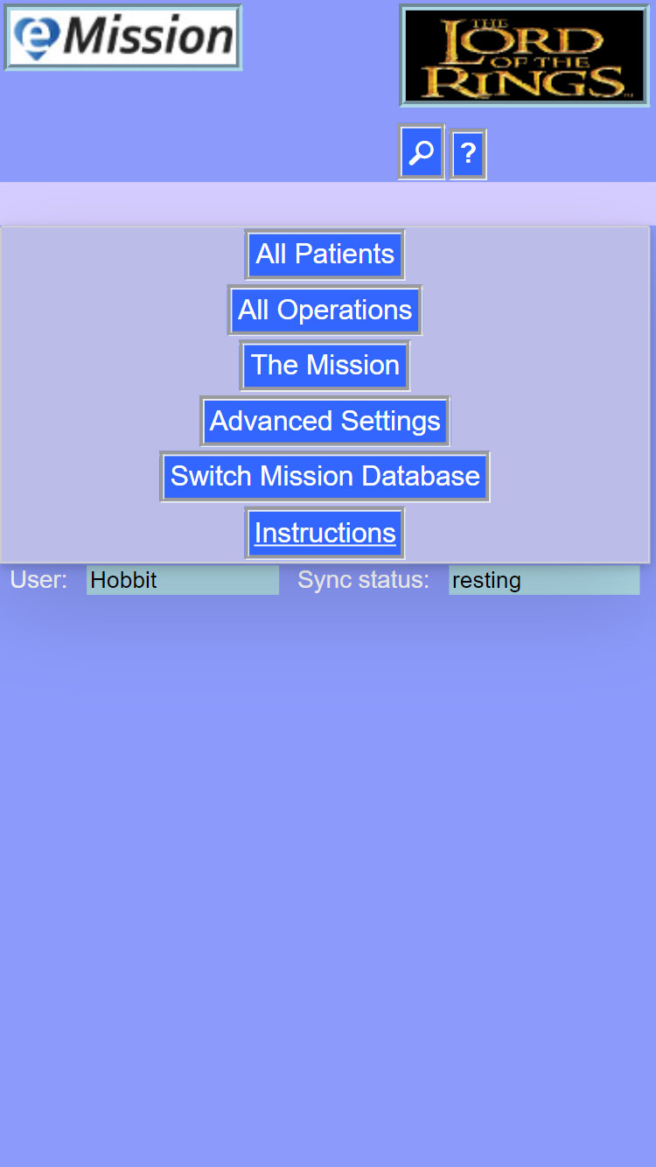
Starting the App
QR code
Email or Letter
URL
https://emissionsystem.org/?address=https%3A%2F%2Femissionsystem.org%3A6984&database=testdb&password=TheShire&username=Hobbit&address=https%3A%2F%2Femissionsystem.org%3A6984&database=testdb&password=test&username=Hobbit

Slide 6




Where are the components located?
credentials
Browser cookies
Remote server
application
Browser cache
Web server
patients
Browser PouchDB
Server CouchDB

Slide 7
Disconnection tolerant using local data copy
credentials
Browser cookies
Remote server
application
Browser cache
Web server
patients
Browser PouchDB
Server CouchDB
…eventual re-synch and bidirectional update

